Slide 1
Безпека дорожнього руху в Європі
Д-р Роберто Ґнесотто
Бюро ВООЗ в Україні
Керівник проекту «Неінфекційні захворювання (НІЗ): профілактика та зміцнення здоров’я в Україні
Notes:
The first Global status report on road safety: time for action was published in 2009 with the accompanying European status report on road safety: towards safer roads and healthier transport and reported that about 120 000 people die annually from road traffic injuries in the WHO European Region.

Slide 2
Глобальні зобов’язання щодо безпеки дорожнього руху
ЦІЛІ СТАЛОГО РОЗВИТКУ
3.6. До 2020 – до 2020 року зменшити на 50% кількість смертей та травмувань внаслідок автомобільних аварій.
11.2. До 2030 – забезпечити доступ до безпечних, доступних та стійких транспортних систем для всіх, підвищуючи безпеку дорожнього руху, зокрема через розвиток громадського транспорту.
ДЕСЯТИЛІТТЯ ДІЙ ПО ЗАБЕЗПЕЧЕННЮ БЕЗПЕКИ ДОРОЖНЬоГО РУХУ 2011-2020 РР.
здороВ’Я 2020: ЄВРОПЕЙСЬКА ПОЛІТИКА ЗДОРОВ’Я І БЛАГОПОЛУЧЧЯ
Notes:
SUSTAINABLE DEVELOPMENT GOAL 3
3.6. By 2020, halve the number of global deaths and injuries from road traffic accidents.
11.2. By 2030, provide access to safe, affordable, accessible and sustainable transport systems for all, improving road safety, notably by expanding public transport, with special attention to the needs of those in vulnerable situations, women, children, persons with disabilities and older persons.
Decade of Action for Road Safety 2011–2020 proclaimed by the United Nations General Assembly in 2010 with a goal to reduce road traffic deaths around the world: 5 millions lives could be saved on the world's roads during the Decade
Health 2020 is the new European health policy framework adopted by the 53 Member States of the Region in 2012

Slide 3
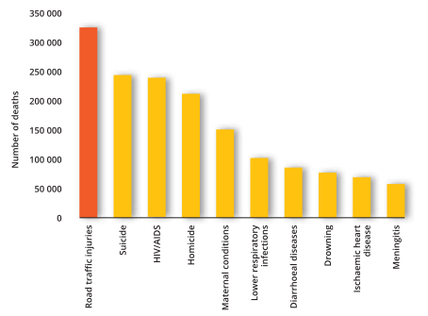
Топ-10 причин смертності серед населення віком від 15 до 29 років (2012 р.)
Notes:
Source: European facts and Global status report on road safety 2015

Slide 4
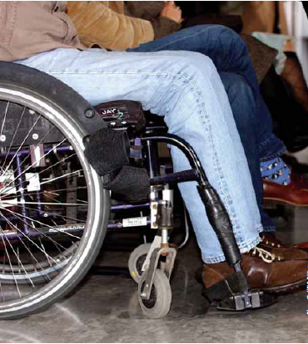
Тягар захворювань внаслідок травмування та інвалідизації
На кожен смертельний випадок припадає 23 нефатальні травмування
Біля 4% випадків травмування у ДТП призводять до втрати працездатності
Необхідне покращення збору статистики з нефатальних травм.
Економічні втрати – до 4% ВВП
Photo: WHO/P. Virot
Notes:
Mortality data give only a partial picture of the true burden of road crashes.
Only 21 countries provided data on the following health outcomes: deaths, hospital admissions and emergency department attendance.
For this set of countries, for every person dying, 23 people were admitted to hospital and 112 people attended an emergency room (emergency department attendance: information reflecting the entire national case load for 12 countries and a sample for 9 countries).
This represents a huge cost for health services.
Three per cent (median value) of those injured in road crashes ended up with a permanent disability.

Slide 5
Фактори ризику
Перевищення швидкості, особливо в міській місцевості
Управління транспортом в нетверезому стані
Невикористання або неправильне користування:
Ременями безпеки
Мотошоломами
Дитячими кріслами
Користування мобільними телефонами
Notes:
Comprehensive urban speed law = maximum urban speed limit of 50 km/h + local autorities allowed to reduce speed limits
Seventy-eight per cent of countries (including all the high-income countries) have legislation that imposes urban speed limits less than or equal to 50 km/h.
Eleven countries (10 of the 11 CIS countries that responded to the questionnaire) still have an urban speed limit exceeding 50 km/h.
Seventy-eight per cent of countries allow local authorities to modify speed limits.
Enforcement needs to be improved: only 12 countries (25%) reported effective enforcement of this legislation.
(only 5 countries rate enforcement as good)

Slide 6
Найбільша помилка, яку можуть зробити батьки: тримати дитину на колінах, а не у дитячому сидінні
Notes:
http://www.huffingtonpost.com/james-baxley/1970s-nostalgia_b_8881148.html

Slide 7
Користування мобільним телефоном під час руху

Slide 8
Що необхідно зробити?
Розбудова та покращення інфраструктури
Контроль швидкості
Безпека транспорту
Виживання
Лідерство
Підкріплення законодавства щодо безпеки дорожнього руху

Slide 9
Висновок
Систематичний підхід через міжсекторальне партнерство
Notes:
About 92 000 people died on roads in the Region in 2010. However, progress has been made in many countries to reduce the number of people dying in road traffic, which has declined by about 25 % in the past three years.
Almost half the countries in the Region now have comprehensive legislation on all five risk factors (speed, drink-driving, seat-belts, child restraints and helmets); the other half need to work towards increasing the adoption of comprehensive legislation relating to the key risk factors for road traffic injuries. This applies especially to low- and middle-income countries, which should conduct legislative reviews to tighten up laws so as to maximize benefits for their citizens.
National road safety strategies with targets are needed, and a lead agency should coordinate implementation to reach the goals of the Decade of Action for Road Safety 2011–2020.
Legislation is still suboptimally enforced in more than half the countries despite being essential to successfully implementing policy. This requires adequate resources supported by strong social marketing campaigns to win public understanding and support.
More attention needs to be paid to the plight of vulnerable road users, which constitute 43% of road deaths in the Region, with a particular focus on motorcyclists and pedestrians. In the EU, continued attention needs to be focused on pedestrians. The forthcoming Second United Nations Global Road Safety Week is an opportunity to focus attention on pedestrians.
The Region has many examples of how non-motorized forms of transport can be safely integrated into more sustainable and safer transport systems. Others should invest in such transport policies that address environmental pressures and protect vulnerable road users. Governments should make increased efforts to ensure that road infrastructure is safer for all road users and to promote physically active forms of transport
Countries, vehicle manufacturers and distributors need to work together to ensure that vehicles meet international crash testing standards.
The quality of data relating to people who are nonfatally injured and disabled in road crashes must be improved. Harmonizing definitions and linking multiple data sources will improve official data estimates.

