Slide 1
Road Safety Week May 2017
Conference 11/05
Safe Roads
Modernization and improvement of
Legal & Institutional System

Slide 2
Our project’s goal and scope
Contribute to decrease number of road accidents/fatalities/injured
Scope is 2-fold
Safer roads
Safer road users

Slide 3
Our project’s tasks & activities
Road infrastructure
Improve design standards
Update planning and design procedures
Update road accident database (collecting and analysis)
Introduce in Ukraine RISM procedures
With reference to Best Practice (EU + PIARC + …)
Management of Road Safety by Ukravtodor
Prepare & implement Communication campaigns
Notes:
Starting presentation from the top
Ukraine needs a ccordination at the highest level

Slide 4
Our project’s tasks & activities (2)
32 activities
1400 + 615 Days
3 year duration
Started December 2015 →17 months elapsed
Notes:
Coordinate players requires that players do play

Slide 5
First results
Technical reports delivered, proposing:
Road design standards (39 + 16 recommendations)
Updated procedures
Experimentation of design / procedures / solutions on some projects and black spot sections
New collecting tool for road accident data
Road Safety Audit Manual
Draft of RISM Law, agreed with Ukrainian Counterpart
Position of Road Safety Unit in Ukravtodor

Slide 6
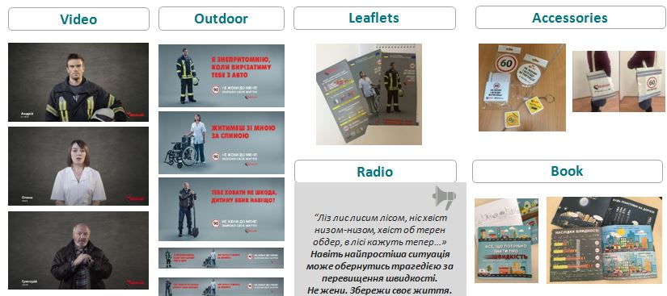
First results (2)
1st communication campaign implemented
On speed
Target: drivers & males & 30-45 years
In Zhytomyr city/oblast

Slide 8
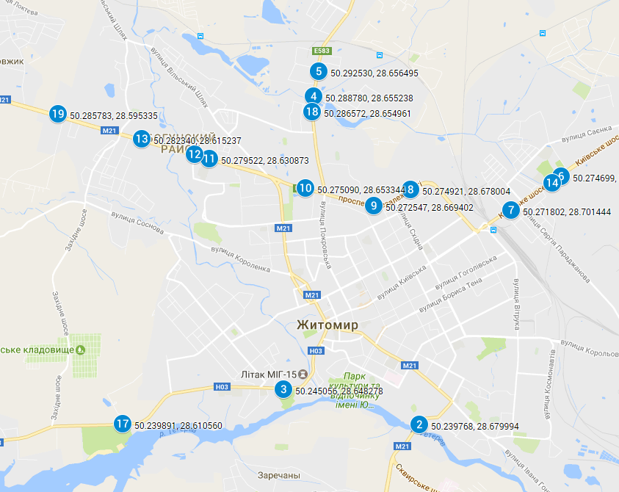
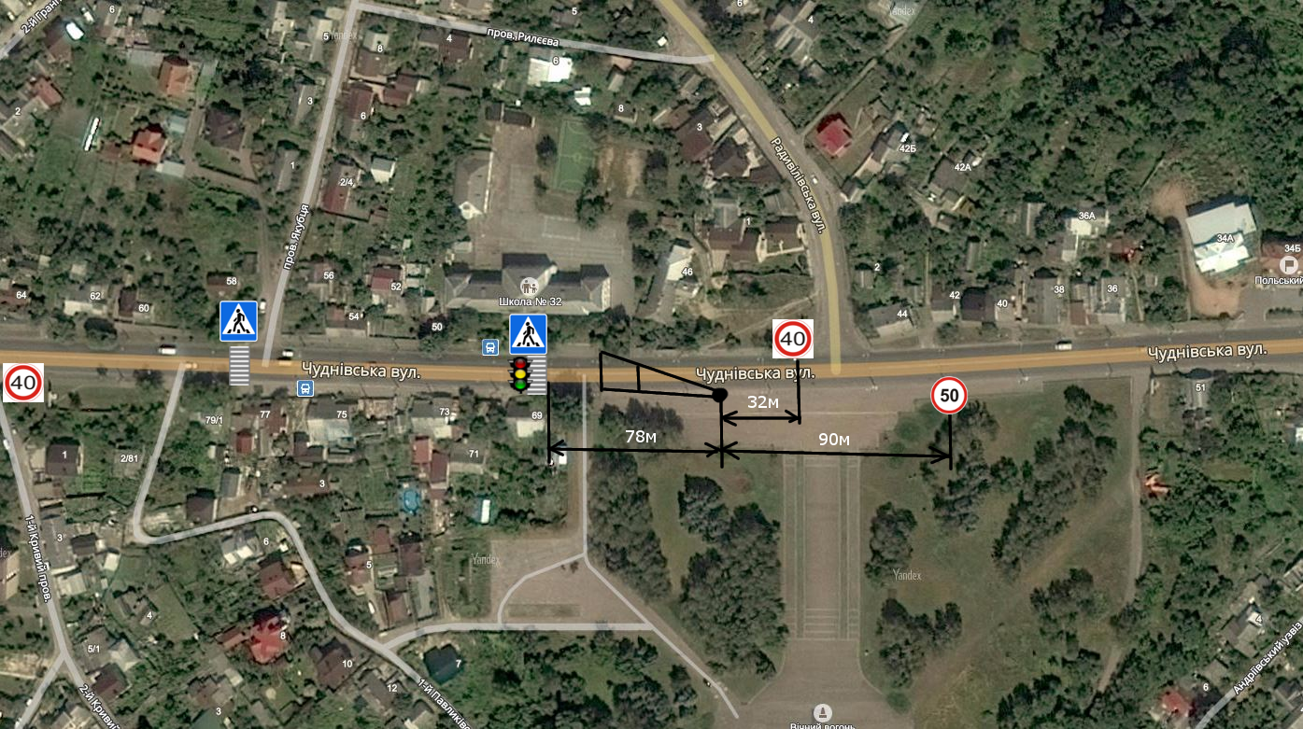
Speed measurement in Zhytomyr
Speed mapping campaign (October, December)

Slide 9
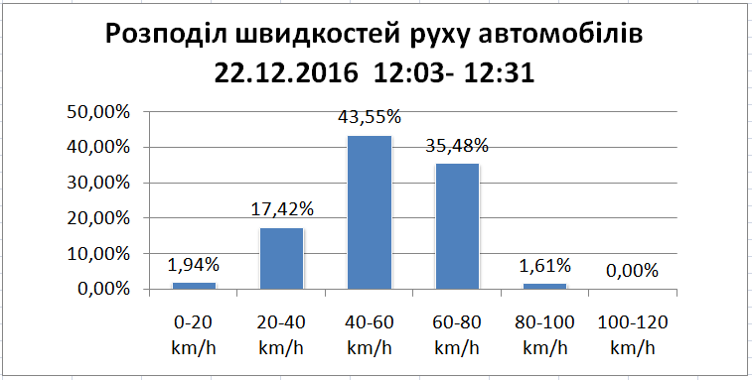

Slide 10
Findings
Safety of roads is not something intrinsic, it
addresses ) people (users / drivers)
and depends on )
The best and safest road is indeed safe or not, depending on
The vehicle
Drivers capacity to drive it

Slide 11
Speed
The speed chosen by driver has an influence:
the road is designed in view of a certain « design speed »
➔ the road is safe for people driving at that speed
➔ statistically, the road is unsafe at higher speeds
Safety / unsafety are linked
directly: to the behaviour of the driver
indirectly: to the capacity of the road to forgive a mis-behaviour
Both the driver’s and the road’s capacities decrease with the speed

Slide 12
Speed (2)
Awareness is important:
Education of drivers
Communication campaigns
Prevention actions (in school)
But without enforcement, the efficiency of pedagogy is much lower
Notes:
More or less important depending on the scope and nature of their activity

Slide 13
First campaign evaluation

Slide 14
Thank you for your attention

